Slide 1


Big Data Analytics
Chapter 1: Introduction to Big Data
By: Urvi Dhamecha

Slide 2

What’s Big Data?
Big data is the term for a collection of data sets so large and complex that it becomes difficult to process using on-hand database management tools or traditional data processing applications.
The challenges include capture, storage, search, sharing, transfer, analysis, and visualization.
The trend to larger data sets is due to the additional information derivable from analysis of a single large set of related data, as compared to separate smaller sets with the same total amount of data, allowing correlations to be found to "spot business trends, determine quality of research, prevent diseases, link legal citations, combat crime, and determine real-time roadway traffic conditions.”

Slide 3
Distributed file system
A distributed file system (DFS) is a file system with data stored on a server.
The DFS makes it convenient to share information and files among users on a network in a controlled and authorized way.

Slide 4
Types of Big Data
Structured Data
Semi-Structured Data
Unstructured Data

Slide 5
Types of Big Data
Structured Data:
Information stored in databases is known as structured data because it is represented in a strict format.
The DBMS then checks to ensure that all data follows the structures and constraints specified in the schema.

Slide 6
Types of Big Data
Semi-Structured Data:
In some applications, data is collected in an ad-hoc manner before it is known how it will be stored and managed.
This data may have a certain structure, but not all the information collected will have identical structure. This type of data is known as semi-structured data.
In semi-structured data, the schema information is mixed in with the data values, since each data object can have different attributes that are not known in advance. Hence, this type of data is sometimes referred to as self-describing data.

Slide 7
Types of Big Data
Unstructured Data:
A third category is known as unstructured data, because there is very limited indication of the type of data.
A typical example would be a text document that contains information embedded within it. Web pages in HTML that contain some data are considered as unstructured data.

Slide 8
Characteristics of big data
Velocity
Volume
Veracity
Variety

Slide 9
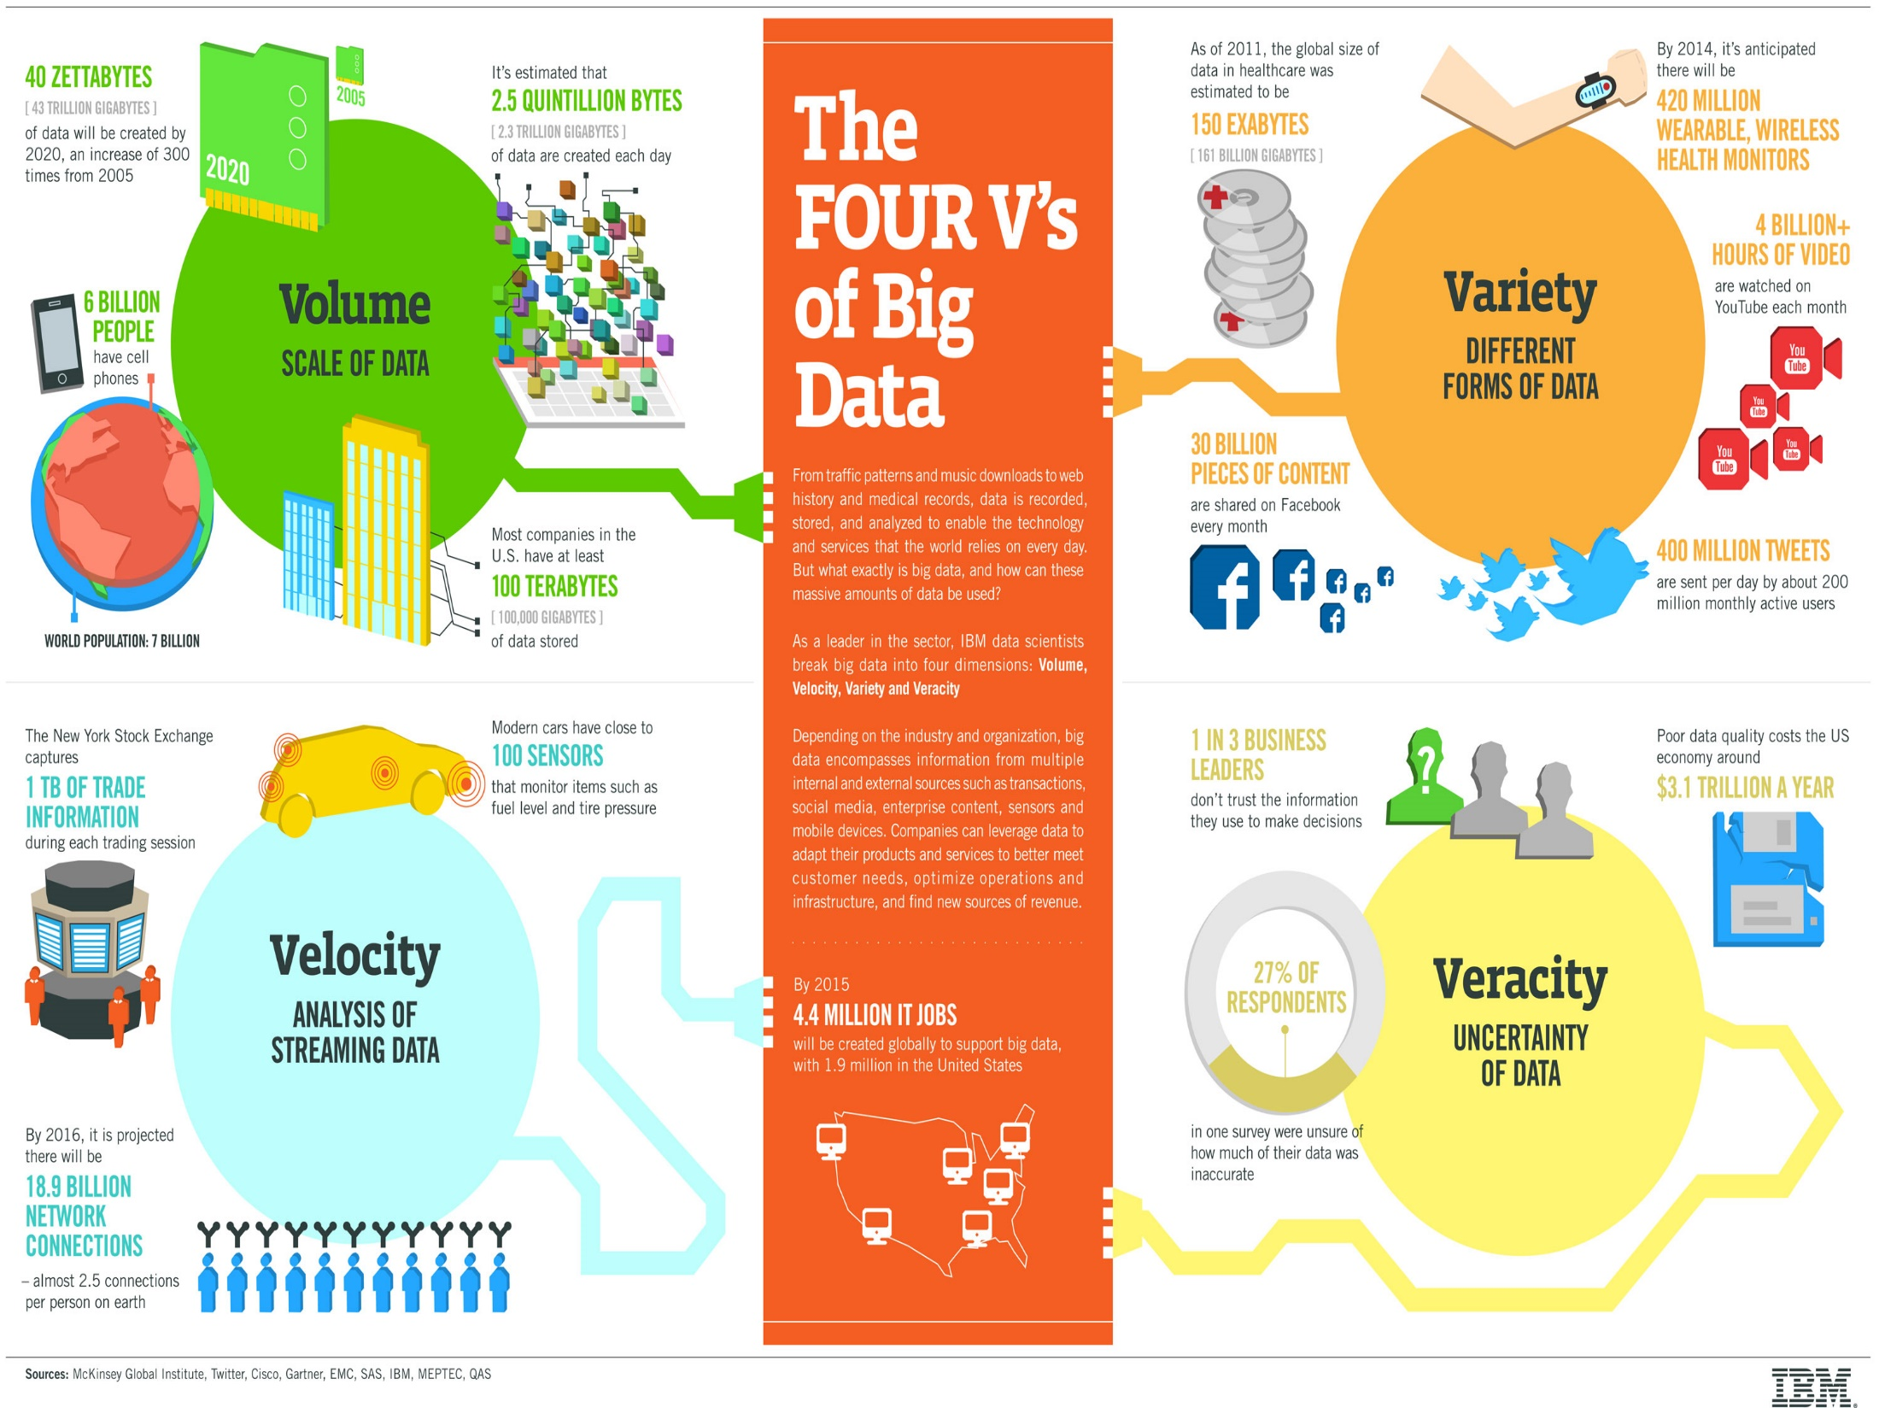
Characteristics of big data

Slide 10
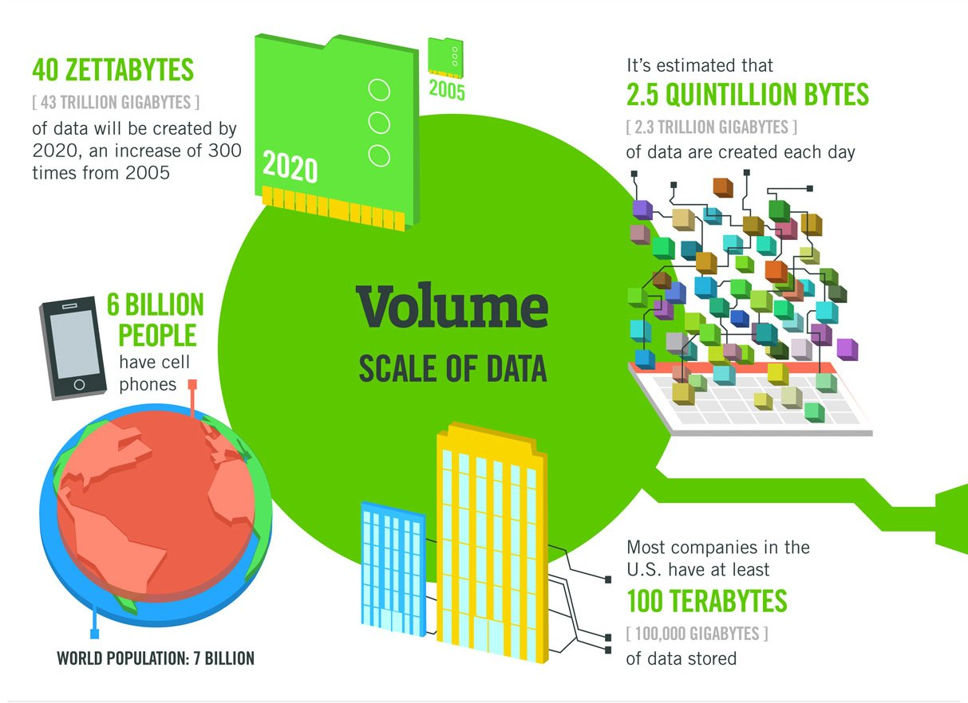
Characteristics of big data
Volume

Slide 11
Characteristics of big data
Volume
Big data is always large in volume. It actually doesn't have to be a certain number of petabytes to qualify.
If your store of old data and new incoming data has gotten so large that you are having difficulty handling it, that's big data.
Remember that it's going to keep getting bigger. Your consultant needs to recommend a scalable solution that can grow with your data.

Slide 12
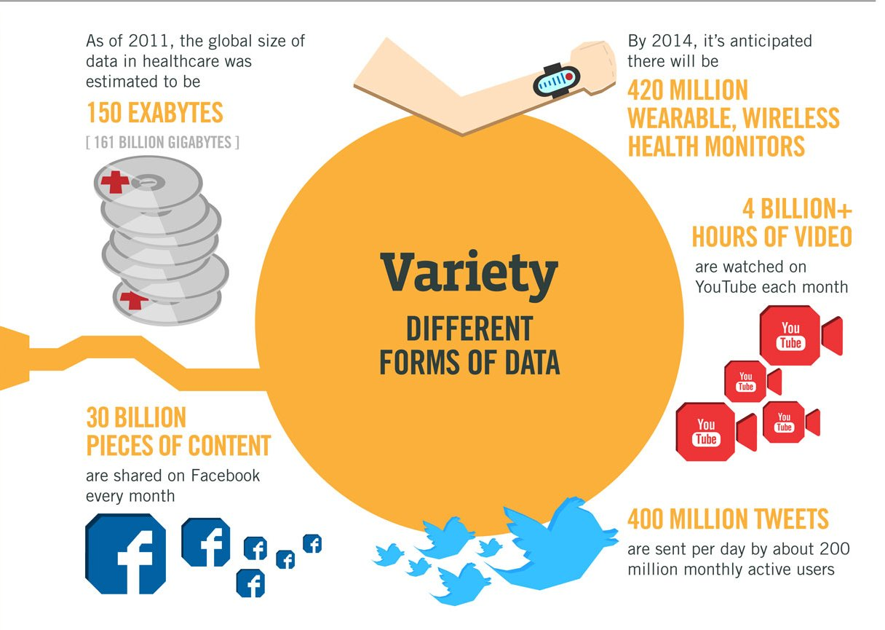
Characteristics of big data
Variety

Slide 13
Characteristics of big data
Variety
Variety points to the number of sources or incoming vectors leading to your databases.
That might be embedded sensor data, phone conversations, documents, video uploads or feeds, social media, and much more.
Variety in data means variety in databases – you'll almost certainly need to add a non-relational database if you haven't already done so.

Slide 14
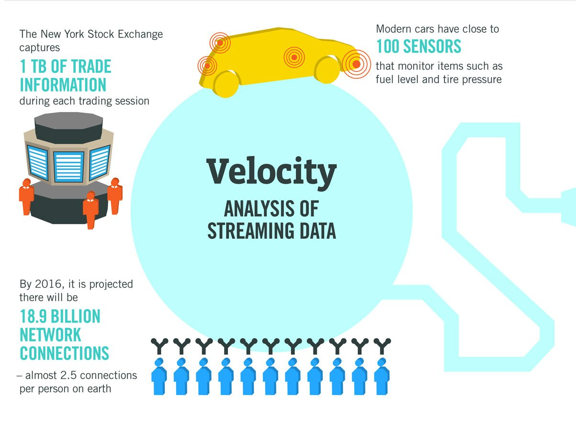
Characteristics of big data
Velocity

Slide 15
Characteristics of big data
Velocity
Velocity or speed refers to how fast the data is coming in, but also to how fast you need to be able to analyze and utilize it.
If you have one or more business processes that require real-time data analysis, you have a velocity challenge.
Solving this issue might mean expanding your private cloud using a hybrid model that allows bursting for additional compute power as-needed for data analysis.
Your consultant may need to offer suggestions for hardware, software, and business process changes to handle today's high-speed data.

Slide 16
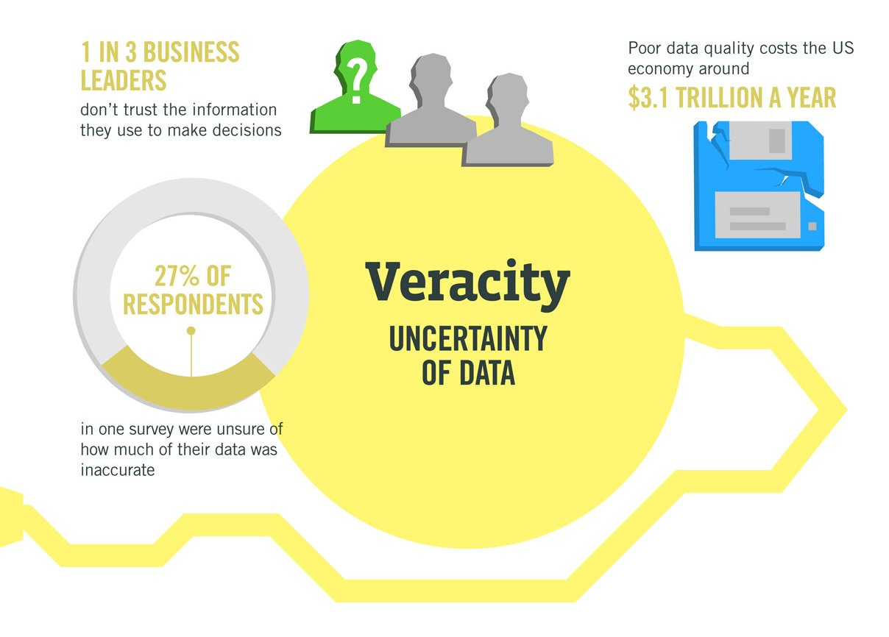
Characteristics of big data
Veracity

Slide 17
Characteristics of big data
Veracity
Veracity is probably the toughest nut to crack.
Veracity refers to the quality, accuracy, integrity and credibility of data.
Gathered data could have missing pieces, might be inaccurate or might not be able to provide real, valuable insight.
Veracity, overall, refers to the level of trust there is in the collected data.
If you can't trust the data itself, the source of the data, or the processes you are using to identify which data points are important, you have a veracity problem.

Slide 18
Characteristics of big data
Veracity
One of the biggest problems with big data is the tendency for errors to snowball.
User entry errors, redundancy and corruption all affect the value of data.
Your consulting firm needs to help you clean your existing data and put processes in place to reduce the accumulation of dirty data going forward.

Slide 19
Big Data V.S. Relational Data
Application | Relation-Based Data | Big Data
Data processing | Single-computer platform that scales with better CPUs, centralized processing. | Cluster platforms that scale to thousands of nodes, distributed process.
Data management | Relational database (SQL), centralized storage. | Non-relational databases that manage varied data types and formats (NoSQL), distributed storage.
Analytics | Batched, descriptive, centralized. | Real-time, predictive and prescriptive, distributed analytics.

Slide 20
Advantage of “Big Data” Analytics
Scalability – nodes can be added to scale the system with little administration.
Unlike traditional RDBMS, no pre-processing is required before storing.
Any unstructured data such as text, images and videos can be stored.
There is no limit to how much data needs to be stored and for how long.
Protection against hardware failure – in case of any node failure, it is redirected to other nodes. Multiple copies of the data are automatically stored.

Slide 21
Big Data Applications
Understanding and targeting users
Understanding and optimizing business processes
Performance optimization
Improving healthcare and public health
Improving sports performance
Improving science and research
Optimizing machine and device performance
Improving security and law enforcement
Improving and optimizing cities and countries
Financial trading

Slide 22
Big Data Architecture
What is Big Data Architecture?
The term "Big Data architecture" refers to the systems and software used to manage Big Data. A Big Data architecture must be able to handle the scale, complexity, and variety of Big Data. It must also be able to support the needs of different users, who may want to access and analyze the data differently.

Slide 23
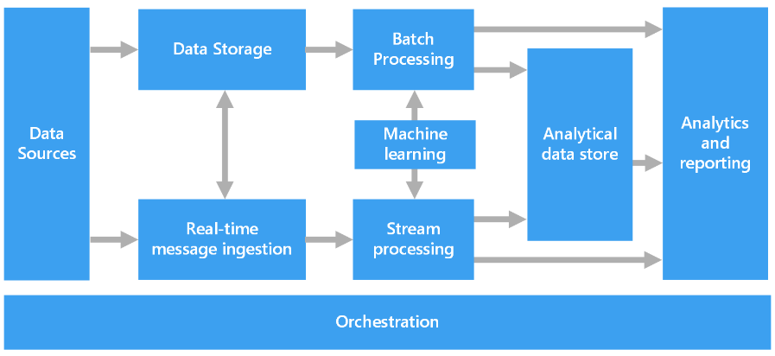
Big Data Architecture

Slide 24
Big Data Architecture
Architecture Layers:
Data ingestion
Data Processing
Data Storage
Data visulization

Slide 25
Big Data Architecture
Data ingestion:
This layer is responsible for collecting and storing data from various sources.
In Big Data, the data ingestion process of extracting data from various sources and loading it into a data repository.
Data ingestion is a key component of a Big Data architecture because it determines how data will be ingested, transformed, and stored.

Slide 26
Big Data Architecture
Data Processing
Data processing is the second layer, responsible for collecting, cleaning, and preparing the data for analysis.
This layer is critical for ensuring that the data is high quality and ready to be used in the future.

Slide 27
Big Data Architecture
Data Storage
Data storage is the third layer, responsible for storing the data in a format that can be easily accessed and analyzed.
This layer is essential for ensuring that the data is accessible and available to the other layers.

Slide 28
Big Data Architecture
Data Visualization
Data visualization is the fourth layer and is responsible for creating visualizations of the data that humans can easily understand.
This layer is important for making the data accessible.

Slide 29
Big Data Storage File System and Distributed File System
Difference between the File system and Distributed File system.
Local File System | Distributed File System
LFS store the data on a single Block. | DFS divides data as multiple blocks and stores it into different DataNodes.
LFS uses Tree format to store Data. | DFS provides Master-Slave architecture for Data storage.
Data retrieval in LFS is slow. | Data retrieval in DFS is fast.
It is not reliable because LFS data does not replicate the Data files. | It is reliable because in DFS data blocks are replicated into different DataNodes.

Slide 30
Big Data Storage File System and Distributed File System
Difference between the file system and Distributed File system.
Local File System | Distributed File System
LFS is cheaper because it does not need extra memory for storing any data file. | DFS is expensive because it needs extra memory to replicate the same data blocks.
Files can be accessed directly in LFS. | Files can not be accessed directly in DFS because the actual location of data blocks are only known by NameNode.
LFS is not appropriate for analysis of very big file of data because it needs large time to process. | DFS is appropriate for analysis of big file of data because it needs less amount of time to process as compare to Local file system.
LFS is less complex than DFS. | DFS is more complex than LFS.

Slide 31
NoSQL
What is NoSQL..?
NoSQL is database management system that provides mechanism for storage and retrieval of massive amount of unstructured data in a distributed environment on virtual servers with the focus to provide high scalability, performance and availability.
NoSQL was developed in response to a large volume of data stored about users, objects and products that need to be frequently accessed and processed.
Some say the term “NoSQL” stands for “non-SQL” while others say it stands for “not only SQL.

Slide 32
Features of NoSQL
NoSQL is next generation database which is completely different from the traditional database.
NoSQL stands for Not only SQL. SQL as well as other query languages can be used with NoSQL databases.
NoSQL is non-relational database, and it is schema-free.
NoSQL is free of JOINs.
NoSQL uses distributed architecture and works on multiple processors to give high performance.
NoSQL databases are horizontally scalable.

Slide 33
Features of NoSQL
Many open-source NoSQL databases are available.
Data file can be easily replicated.
NoSQL uses simple API (Application Programming Interface).
NoSQL can manage huge amount of data.
NoSQL can be implemented on commodity hardware which has separate RAM and disk (shared nothing concept).

Slide 34
Why NoSQL..?
A relational database product can deal with more predictable, structured data.
NoSQL is required because today’s industry needs an agile system that can process unstructured and unpredictable data dynamically.
NoSQL is known for its high performance with high availability, rich query language, and easy scalability as per the need.
SQL supports atomicity, consistency, isolation, durability (ACID) properties.
NoSQL supports CAP theorem.

Slide 35
CAP Theorem
Consistency, Availability, Partition tolerance (CAP) theorem, also called as Brewer’s theorem.
Consistency guarantees all storage and their replicated nodes have the same data at the same time.
Availability means every request is guaranteed to receive a success or failure response.
Partition tolerance guarantees that the system continues to operate in spite of arbitrary partitioning due to network failures.

Slide 36
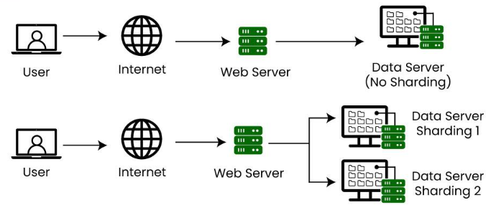
Sharding
Database sharding is a technique for horizontal scaling of databases, where the data is split across multiple database instances, or shards, to improve performance and reduce the impact of large amounts of data on a single database.

Slide 37
Sharding
Sharding Architectures:
Key Based Sharding
Horizontal or Range Based Sharding
Vertical Sharding
Directory-Based Sharding

Slide 38
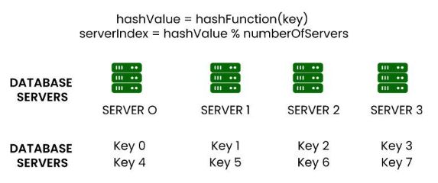
Sharding
Key Based Sharding

Slide 39
Sharding
Key Based Sharding
This technique is also known as hash-based sharding.
Here, we take the value of an entity such as customer ID, customer email, IP address of a client, zip code, etc and we use this value as an input of the hash function.
This process generates a hash value which is used to determine which shard we need to use to store the data.
We need to keep in mind that the values entered into the hash function should all come from the same column (shard key) just to ensure that data is placed in the correct order and in a consistent manner.
Basically, shard keys act like a primary key or a unique identifier for individual rows.

Slide 40
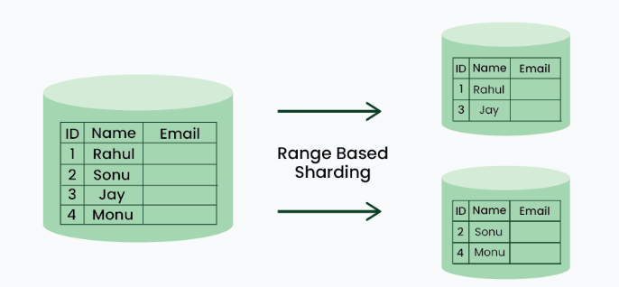
Sharding
Horizontal or Range Based Sharding

Slide 41
Sharding
Horizontal or Range Based Sharding
In this method, we split the data based on the ranges of a given value inherent in each entity.
Let’s say you have a database of your online customers’ names and email information.
You can split this information into two shards. In one shard you can keep the info of customers whose first name starts with A-P and in another shard, keep the information of the rest of the customers.

Slide 42
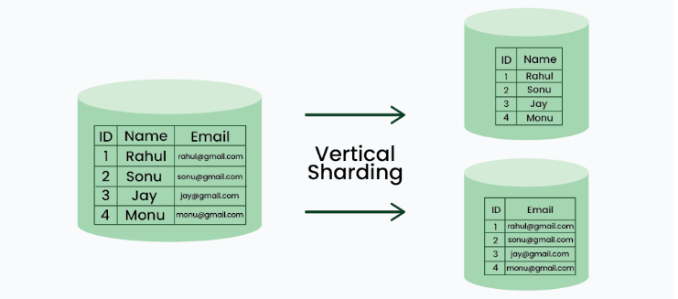
Sharding
Vertical Based Sharding

Slide 43
Sharding
Vertical Based Sharding
In this method, we split the entire column from the table and we put those columns into new distinct tables.
Data is totally independent of one partition to the other ones.
Also, each partition holds both distinct rows and columns.
We can split different features of an entity in different shards on different machines.

Slide 44
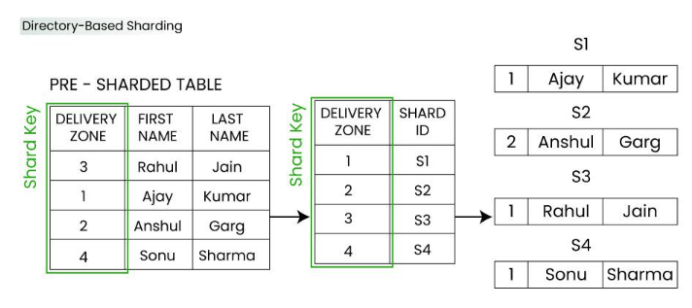
Sharding
Directory Based Sharding

Slide 45
Sharding
Directory Based Sharding
In this method, we create and maintain a lookup service or lookup table for the original database.
Basically we use a shard key for lookup table and we do mapping for each entity that exists in the database.
This way we keep track of which database shards hold which data.

Slide 46
Replication
What is Replication?
Data replication is the process of creating and maintaining multiple copies of the same data in different locations or on different storage devices.
The goal of data replication is to improve data availability, reliability, and fault tolerance.
By having multiple copies of data, systems can continue to function even if one copy becomes unavailable due to hardware failure, network issues, or other reasons.
Data replication is commonly used in distributed systems, databases, and storage systems to ensure that data is always accessible and to improve system performance and scalability.

Slide 47
Replication
Benefits of data replication:
Improve the availability of data
Increase the speed of data access
Enhance server performance
Accomplish disaster recovery

Slide 48
Replication
Improve the availability of data
When a particular system experiences a technical glitch due to malware or a faulty hardware component, the data can still be accessed from a different site or node.
Data replication enhances the resilience and reliability of systems by storing data at multiple nodes across the network.
Increase data access speed
In organizations where there are multiple branch offices spread across the globe, users may experience some latency while accessing data from one country to another.
Placing replicas on local servers provides users with faster data access and query execution times.

Slide 49
Replication
Enhance server performance
Database replication effectively reduces the load on the primary server by dispersing it among other nodes in the distributed system, thereby improving network performance.
By routing all read-operations to a replica database, IT administrators can save the primary server for write-operations that demand more processing power.
Accomplish Disaster recovery
Businesses are often susceptible to data loss due to a data breach or hardware malfunction.
During such a catastrophe, the employees' valuable data, along with client information can be compromised.
Data replication facilitates the recovery of data which is lost or corrupted by maintaining accurate backups at well-monitored locations, thereby contributing to enhanced data protection.

Slide 50
Replication
Types of data replication
Full table replication
Transactional replication
Snapshot replication
Merge replication
Key-based incremental replication

Slide 51
Replication
Full table replication
Full table replication means that the entire data is replicated. This includes new, updated as well as existing data that is copied from source to the destination.
This method of replication is generally associated with higher costs since the processing power and network bandwidth requirements are high.
However, full table replication can be beneficial when it comes to the recovery of hard-deleted data.

Slide 52
Replication
Transactional replication
In this method, the data replication software makes full initial copies of data from origin to destination following which the subscriber database receives updates whenever data is modified.
This is more efficient mode of replication since fewer rows are copied each time data is changed.
Transactional replication is usually found in server-to-server environments.

Slide 53
Replication
Snapshot replication
In Snapshot replication, data is replicated exactly as it appears at any given time.
Unlike other methods, Snapshot replication does not pay attention to the changes made to data.
This mode of replication is used when changes made to data tends to be infrequent; for example performing initial synchronizations between publishers and subscribers

Slide 54
Replication
Merge replication
This type of replication is commonly found in server-to-client environments and allows both the publisher and subscriber to make changes to data dynamically.
In merge replication, data from two or more databases are combined to form a single database thereby contributing to the complexity of using this technique.

Slide 55
Replication
Key-based incremental replication
Also called key-based incremental data capture, this technique only copies data changed since the last update.
Keys can be looked at as elements that exist within databases that trigger data replication.
Since only a few rows are copied during each update, the costs are significantly low.
However, the drawback lies in the fact that this replication mode cannot be used to recover hard deleted data, since the key value is also deleted along with the record.

Slide 56
ACID and BASE Properties
ACID Model:
To explain ACID in more detail and easy way is to understand through breaking down the acronym, ACID:
Atomicity: This property states transaction must be treated as an atomic unit, that is, either all of its operations are executed or none, and there must be no state in a database where a transaction is left partially completed also the states should be defined either before the execution of the transaction or after the execution of the transaction.

Slide 57
ACID and BASE Properties
ACID Model:
Consistency: The database must remain in a consistent state after any transaction also no transaction should have any adverse effect on the data residing in the database and if the database was in a consistent state before the execution of a transaction, then it must remain consistent after the execution of the transaction as well.
Isolation: In a database system where more than one transaction is being executed simultaneously and in parallel, the property of isolation states that each one of the transactions is going to be administered and executed as it is the only transaction in the system also no transaction will affect the existence of any other transactions.

Slide 58
ACID and BASE Properties
ACID Model:
Durability: The database should be durable enough to hold all its latest updates even if the system fails or restarts so, In a practical way of saying that if a transaction updates a chunk of data in a database and commit is performed then the database will hold the modified data but if the commit is not performed then no data is modified and it can only be done when the system start.

Slide 59
ACID and BASE Properties
BASE Model:
Acronym BASE stands for:-
Basically Available: Instead of making it compulsory for immediate consistency, BASE-modelled NoSQL databases will ensure the availability of data by spreading and replicating it across the nodes of the database cluster.
Soft State: Due to the lack of immediate consistency, the data values may change over time. The BASE model breaks off with the concept of a database that obligates its own consistency, delegating that responsibility to developers.

Slide 60
ACID and BASE Properties
BASE Model:
Eventually Consistent: The fact that BASE does not obligates immediate consistency but it does not mean that it never achieves it. However, until it does, the data reads are still possible (even though they might not reflect reality).

Slide 61
ACID and BASE Properties
Difference between ACID and BASE:
S. No | Criteria | ACID | BASE
1. | Simplicity | Simple | Complex
2. | Maintenance | High | Low
3. | Consistency Of Data | Strong | Weak/Loose
4. | Concurrency scheme | Exact Answer | Close to answer
5. | Scaling | Vertical | Horizontal

Slide 62
ACID and BASE Properties
S. No | Criteria | ACID | BASE
6. | Implementation | Easy to implement | Difficult to implement
7. | Upgrade | Harder to upgrade | Easy to upgrade
8. | Type of database | Robust | Simple
9. | Type of code | Simple | Harder
10. | Time required for completion | Less time | More time.
11. | Examples | Oracle, MySQL, SQL Server, etc. | DynamoDB, Cassandra, CouchDB, SimpleDB etc.

Slide 63


